Slide 1

Leadership and the Project Manager
http://blog.mcafeeinstitute.com/wp-content/uploads/2015/03/leaderclipartleadershipclipartpicture.jpg
Lecture 4

Slide 2

What is Leadership?
Defined as the ability to inspire confidence and support among the people who are needed to achieve organizational goals.
http://newsletterville.com/img2013/issue204_handwriting.jpg

Slide 3
Leaders versus Managers
Leaders create a sense of partnership. The teamwork is needed in order to achieve the common goal.
Four things are necessary to promote the partnership idea between project manager and team:
Exchange of purpose. Partnerships require that every member knows the goals and vision of a project.
A right to say "NO". It is important that all members of the team can disagree. Supporting peoples right to voice their professional disagreement is a cornerstone of a partnership. Loosing arguments is acceptable, loosing the right to disagree is not.
Joint accountability. In a partnership each member of the project team is responsible for the project's outcomes and the current situation (positive or negative).
Absolute honesty. Partnerships demand authenticity. Because of the respect of each team member's role, an implicit pact that all information becomes community information is made.

Slide 4
Leaders versus Managers (cont’d)
A manager is an individual who has received a title
within the organization that permits him/her
to plan, organize, direct, and control the behavior
of others within the department or area of oversight.
Leadership may be part of the manager's job,
but the other management
roles are more administrative in nature.

Slide 5
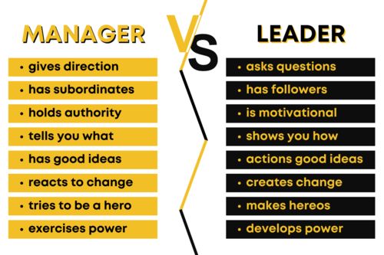
Differences Between Managers and Leaders
Nextgeneration.ie

Slide 6
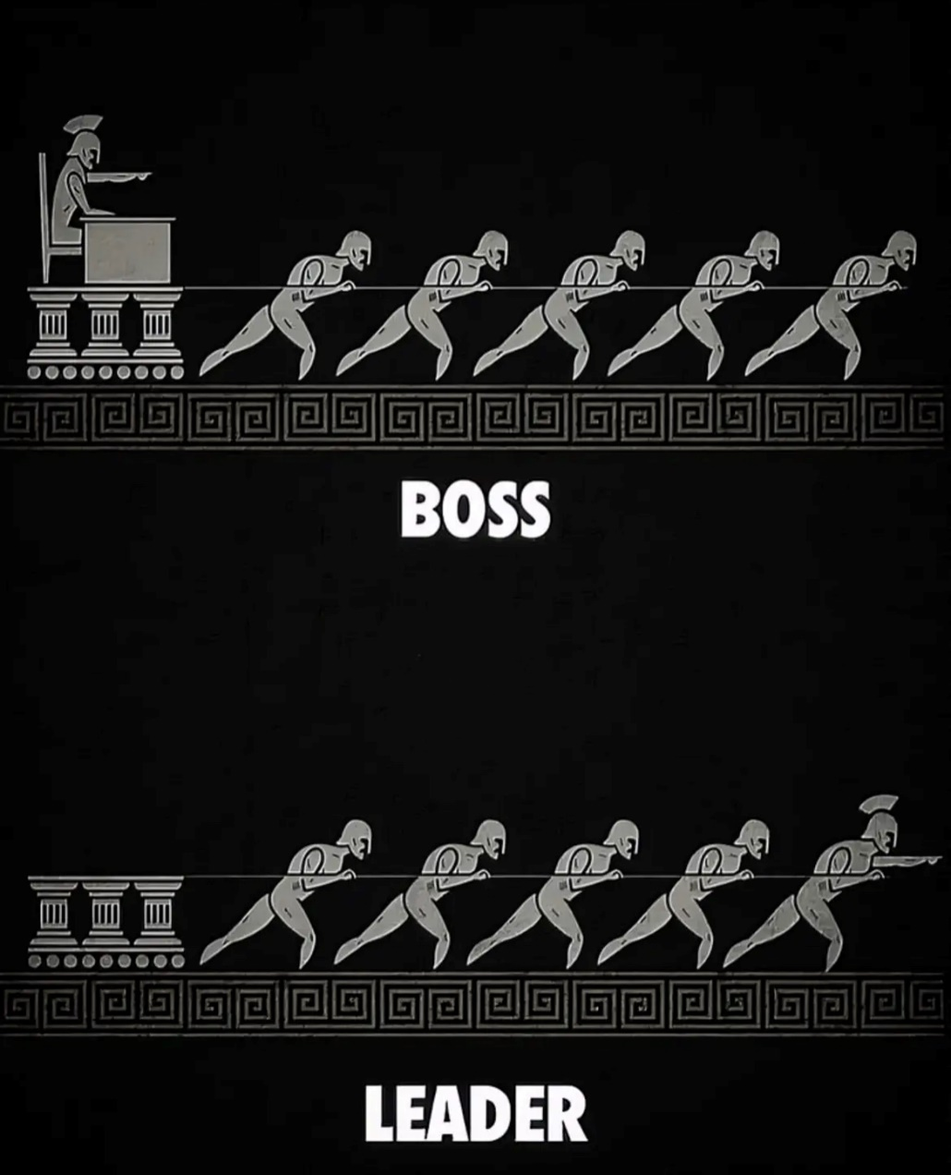
Differences Between Managers and Leaders
Nextgeneration.ie

Slide 7
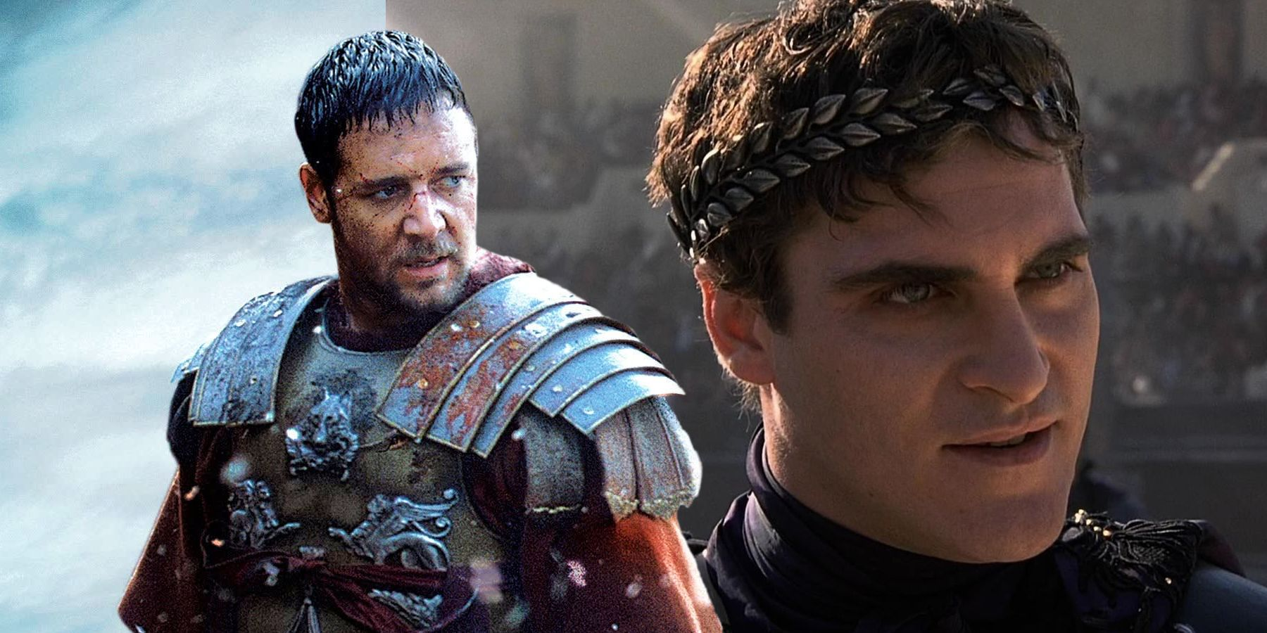
Differences Between Managers and Leaders
https://www.youtube.com/watch?v=lEM5nJ-AUiM

Slide 8
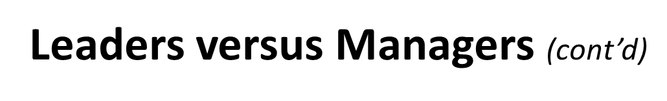
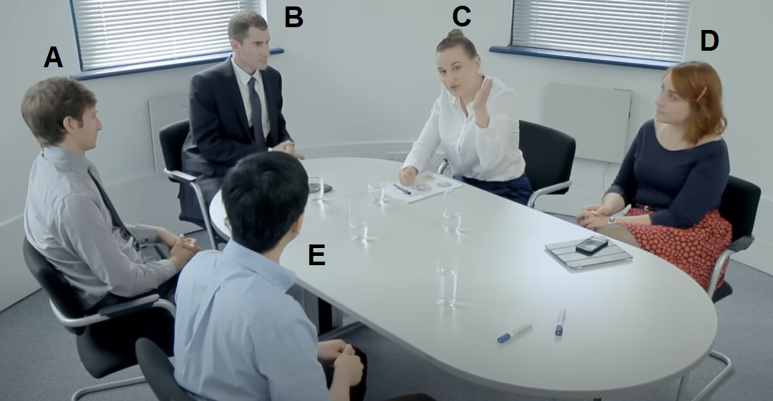
Terry Tate the Office Linebacker
https://www.youtube.com/watch?v=RzToNo7A-94
Is Terry Tate a leader, or a manager? Why?
Al Pacino’s Pre-Game Speech in “Any Given Sunday”
https://www.youtube.com/watch?v=oSDhhZtRwFU
Is Al Pacino’s character a leader, or a manager? Why?
The Expert (Short Comedy Sketch)
https://www.youtube.com/watch?v=BKorP55Aqvg
Who in the video is the manager? Who is the leader?
What other stakeholders attended the meeting?

Slide 9
The New Project Leadership
Project Management requires each of us to harness our abilities
to lead others. These skills may or (more likely) may not be
innate. For most, leadership is not something we are born with.
However, we recognize that leaders are as leaders do.
Dr. Warren Bennis, one of the top writers on organizational
Leadership summarizes four competencies that determine our
success as project leaders:

Slide 10
The New Project Leadership (cont’d)
The new leader understands and practices the power of appreciation. They are connoisseurs of talent, more curators than creators. Appreciation derives from our ability to recognize and reward the talent of others. Leaders may not be the best, most valuable, or most intelligent member of the team. Their role is not to outshine but allow others to develop to their best potential.
The new leader keeps reminding people what's important. This simple statement carries a powerful message for project managers. We need to be aware that in pursuing a project, a host of other problems, difficulties, annoyances, and new technical and human challenges will arise. The project manager must remember that one of the most important contributions is reminding people to keep their eye fixed on the ultimate prize.

Slide 11
The New Project Leadership (cont’d)
The new leader generates and sustains trust. The most important characteristic each of us looks for in leaders is honesty. If a leader generates trust and behaves with authenticity, fairness, honesty, and caring, he will be successful in creating an environment in which the project team strives to do their best.
The new leader and the led are intimate allies. Project Management leadership does not arise in order to control and dominate the project team, but as a natural method for supporting the team's efforts.

Slide 12
How the PM leads
The PM's job encapsulates, in many ways, the role of a mini-CEO,
someone who is expected to manage holistically, focusing on the
complete project management process from start to finish.
The PM must take on a variety of duties and roles to successfully
manage their projects:
Acquiring Project Resources
Motivating and Building Teams
Having a Vision and Fighting Fires
Communicating (A PM can not get up in the morning and think “I don't want to communicate today”)

Slide 13
Leadership Styles
What do you think makes a Project Manager successful?
Project managers must understand that to successfully
lead their teams they must employ multiple leadership
styles to handle various team members and situations.
THE FIVE MOST COMMON LEADERSHIP STYLES ARE:
The Command and Control
Relating Management
Democratic Management
Hands-On
Coaching Management

Slide 14
#1. The Command & Control Style
This style is appropriate when you know the best way to do something and the person you’re working with does not.
It’s very effective when dealing with beginners. They need specific direction and you’re the best person around to get them started.
This style also works well in a crisis. In this situation you need a take-charge project leader who tells people exactly what to do to fix the problem.

Slide 15
#1. The Command & Control Style (cont’d)
All great managers know how to deploy this style convincingly when a situation calls for it.
Caution should be exercised when using this method as it does not work in all situations and can be very damaging to a team if used excessively.
It can lead to your team feeling devalued and reinforces learned helplessness.
It prevents creativity and initiative in individuals and can often drive these type of members from your team.

Slide 16
#2. The Relating Management Style
Effective Project Managers build rapport among people on their team. They encourage them to bond with each other, work as a team and by focusing people on common goals.
They also know what it takes to build rapport with their people. They can relate to those they work with, they’re likable and social.
They take a sincere interest in the lives of team members. When they ask about someone’s family or personal interests, they’re using the Relating Style.

Slide 17
#2. The Relating Management Style (cont’d)
The downside to this style is that a Project Manager that uses this style too much can not make the tough decisions when required and can not “take charge” when required to if a crisis develops. They are often too emotionally engaged with their team members.
If this style is used to excess they can be viewed as “weak” and “ineffective”. Team members may lose respect for the Project Manager and may take matters into their own hands to get the project done.

Slide 18
#3. The Democratic Management Style
The Democratic style is all about gaining buy-in and building team consensus. It lets team members know that you value their input and that you’re open to hearing new ideas and suggestions.
Great managers understand this. They deploy the democratic style in planning activities and get buy-in from all key stakeholders.

Slide 19
#3. The Democratic Management Style (cont’d)
You want to plan democratically for two reasons:
First, when you get input from lots of people, particularly those who will actually implement the plan – your plan will be reality-based and you’ll be less likely to leave out something that’s mission critical.
Second, when you plan democratically, people feel their voice has been heard and they “own” the plan. Obviously, you need to sign off on the final draft, adding and subtracting as necessary. But by planning democratically you avoid the worst possible scenario – where detached leaders devise a plan in isolation and then hand it off. The implementers will resent not being asked for their input, and they’ll fight it tooth and nail.

Slide 20
#3. The Democratic Management Style (cont’d)
This managerial style can be overused, however. We just talked about how planning needs to be democratic. But execution often requires an autocratic style.
Imagine that an entire department gets behind on a project and could cause your company to miss a mission critical deadline. That’s no time for consensus building, is it? You need a tough manager who can light a fire under people and hit the deadline.

Slide 21
#4. The Hands-On Style
This approach works when project managers need to step in and get the job done. If a team member can’t figure out how to finish the job, the leader can model the way by taking over the task to ensure it gets completed.
Hands-On managers are often high performers who really are more competent than others, and their natural tendency is fix problems themselves, even if people only asked for their advice.
Like Command & Control approach, it can be disempowering and lead to low morale.

Slide 22
#5. The Coaching Management Style
Coaching is about the long-term development of people. For managers who over-rely on the Command and Control and Hands On styles – both of which achieve short-term objectives — the coaching style is the one that most needs to be developed.
Project Managers that utilize this method understand the value of asking questions that direct people to uncover their own solutions. They advise and follow up to be sure people meet their goals on time.

Slide 23
Leadership Style Examples
The following movie clips demonstrate various leadership styles
that we will discuss in this lecture. As we go through the lecture
try to determine which clip shows which type of leadership style.

Slide 24

Clip # 1 – “We Were Soldiers
https://www.youtube.com/watch?v=0fpK9591u6M

Slide 25
Clip # 2 – “Leadership Lessons”
https://www.youtube.com/watch?v=w8fu-hq3S7A

Slide 26
Clip # 3 – “The Blind Side”
https://www.youtube.com/watch?v=76nhIfp9gr0

Slide 27
Clip # 4 – “Leadership Styles”
https://www.youtube.com/watch?v=8YtpTK-AFoQ

Slide 28
Clip # 5 – “What Leadership Style is this?”
https://www.youtube.com/watch?v=Bv16yctXaFM

Slide 29
Your Leadership Style
Complete the Leadership Quiz
below and determine what your Leadership style is.

Slide 30
Statements | Strongly disagree | Disagree | Neutral | Agree | Strongly agree
1. Employees need to be supervised closely, or | 1 | 2 | 3 | 4 | 5
they are not likely to do their work.
2. Employees want to be a part of the | 1 | 2 | 3 | 4 | 5
decision-making process.
3. In complex situations, leaders should let | 1 | 2 | 3 | 4 | 5
subordinates work problems out on their own.
4. It is fair to say that most employees in the | 1 | 2 | 3 | 4 | 5
general population are lazy.
5. Providing guidance without pressure is the | 1 | 2 | 3 | 4 | 5
key to being a good leader.
6. Leadership requires staying out of the way of | 1 | 2 | 3 | 4 | 5
subordinates as they do their work.

Slide 31
7. As a rule, employees must be given rewards | 1 | 2 | 3 | 4 | 5
or punishments in order to motivate them to
achieve organizational objectives.
8. Most workers want frequent and supportive | 1 | 2 | 3 | 4 | 5
communication from their leaders.
9. As a rule, leaders should allow subordinates | 1 | 2 | 3 | 4 | 5
to appraise their own work.
10. Most employees feel insecure about their | 1 | 2 | 3 | 4 | 5
work and need direction.
11. Leaders need to help subordinates accept | 1 | 2 | 3 | 4 | 5
responsibility for completing their work.
12. Leaders should give subordinates complete | 1 | 2 | 3 | 4 | 5
freedom to solve problems on their own.

Slide 32
13. The leader is the chief judge of the | 1 | 2 | 3 | 4 | 5
achievements of the members of the group
14. It is the leader’s job to help subordinates find | 1 | 2 | 3 | 4 | 5
their “passion.”
15. In most situations, workers prefer little input | 1 | 2 | 3 | 4 | 5
from the leader.
16. Effective leaders give orders and clarify | 1 | 2 | 3 | 4 | 5
procedures.
17. People are basically competent and if given a | 1 | 2 | 3 | 4 | 5
task will do a good job.
18. In general, it is best to leave subordinates | 1 | 2 | 3 | 4 | 5
alone.

Slide 33
Scoring
1. Sum the responses on items 1, 4, 7, 10, 13, and 16
2. Sum the responses on items 2, 5, 8, 11, 14, and 17
3. Sum the responses on items 3, 6, 9, 12, 15, and 18

Slide 34
Scoring
1. Sum the responses on items 1, 4, 7, 10, 13, and 16 Command and Control Style
2. Sum the responses on items 2, 5, 8, 11, 14, and 17 Democratic Management Style
3. Sum the responses on items 3, 6, 9, 12, 15, and 18 Relating Management Style

Slide 35
Leadership and Emotional Intelligence
Emotional intelligence is defined as the ability to understand and manage your own emotions, as well as recognize and influence the emotions of those around you.
“The most effective leaders are all alike in one crucial way: They all have a high degree of what has come to be known as emotional intelligence. It’s not that IQ and technical skills are irrelevant. They do matter, but...they are the entry-level requirements for executive positions.” -Daniel Goleman
The key components of emotional intelligence are
Self Awareness
Self Regulation
Motivation
Empathy
Social Skills

Slide 36
Leadership and Emotional Intelligence
Self Awareness
Implies having a deep understanding of one's own strengths, weaknesses, ego needs, drives, and motives. Have a clear perspective of oneself.
Self Regulation
A key ability in successful leaders is their ability to keep themselves under control. Think before you act.
Motivation
Effective project leaders are consistently highly motivated individuals. They are driven to achieve their maximum potential and they recognize that in order to be successful, they must also work with members of the project team to generate the maximum performance from each of them.
Empathy
A strong leader must show willingness to consider other team member's feelings in the process of making an informed decision.
Social Skill
A strong leader can manage relationships with purpose.

